Slide 1
Cloud Migration
Product Strategy

Slide 2
Product PRD/ Product Vision Board
Problem description/ Vision Statement
Key Goals and Requirements/Business Goals
Enable a secure, scalable, and cost-effective cloud environment that enhances business agility, supports rapid innovation, and improves operational efficiency across the organization.
Objectives:
Improve scalability and flexibility to support business growth.
Reduce infrastructure costs and improve cost predictability.
Enhance security, data protection, and compliance with industry regulations.
Provide a high-performing, reliable infrastructure that ensures minimal downtime.
Please refer to the project PRD for more details

Slide 3
Target Group (Key Stakeholders)
Primary Stakeholders:
IT/Infrastructure Teams
Analytics and Data Teams
Development/Engineering Teams
Risk and Compliance Teams
Customer Success and Support Team
Secondary Stakeholders
Business Leadership
Finance and Procurement
End Users
Please refer to the project PRD for more details

Slide 4
Needs (Problems to Solve)
Scalability Limitations
High Operational Costs
Security and Compliance
Limited Agility
Inconsistent Performance
Data Accessibility
Please refer to the project PRD for more details

Slide 5
Product (Solution/Features)
Scalable Cloud Infrastructure:
Cost Management and Optimization Tools:
Enhanced Security and Compliance:
Automated Deployment and DevOps Integration:
Real-Time Analytics and Data Integration:
Backup, Recovery, and Disaster Recovery:
Monitoring and Alerting Systems
Please refer to the project PRD for more details

Slide 6
Business Goals (Key Results)
Goal 1: Improve Operational Efficiency
Goal 2: Achieve Cost Savings
Goal 3: Enhance Security and Compliance
Goal 4: Increase Scalability and Resilience
Goal 5: Drive Business Agility and Innovation
Please refer to the project PRD for more details

Slide 7
Metrics (KPIs)
Cost Efficiency
System Uptime and Performance
Security and Compliance
User Satisfaction and Adoption
Operational Efficiency
Please refer to the project PRD for more details

Slide 8
Potential Risks and Mitigation Strategies
Risk: Data Loss or Corruption
Mitigation: Perform regular backups before, during, and after migration; validate data integrity post-migration.
Risk: Downtime During Migration
Mitigation: Conduct phased migration and plan during low-traffic times; implement a rollback strategy.
Risk: Cost Overruns
Mitigation: Implement real-time cost monitoring and budget alerts; use reserved instances where applicable.
Risk: Compliance and Security Breaches
Mitigation: Ensure all configurations meet compliance standards; conduct security audits and maintain IAM policies.
Risk: Change
Mitigation: Provide training, clear communication, and support resources to ease the transition for users.
Please refer to the project PRD for more details

Slide 9
Product PRD
Success Metrics/Goals
Metrics | Priority | Impact | Urgency | Reason
Establish automated backups and disaster recovery plans, with a recovery time objective, RTO of 2 hours. | High | High | Immediate | Backup and disaster recovery with a strict RTO is critical for data protection and business continuity, especially during and immediately after migration when risks are highest.
Improve application performance by: e.g., response time by 20%. | Medium | High | Medium | Enhanced performance impacts user experience and system efficiency, but it can be optimized continuously after the initial migration.
Achieve availability target 99.9% uptime post-migration. | High | High | High | Availability directly affects customer satisfaction and service reliability, making it an essential post-migration metric.
Decrease deployment times by 50% or more | Medium | Medium | Medium | Faster deployments improve agility, but they become most beneficial once systems are stable and available. This can be optimized after achieving core stability and backup goals.
Reduce operational costs by 90%. | Medium to Low | High | Low | Cost reduction is valuable, but immediate stability, availability, and performance take precedence. Operational cost optimization can be approached incrementally post-migration.

Slide 10
Competitors
Competitors
Public cloud
Aws, Azure, Google

Slide 11
Competitor Analysis
Compute
Feature | AWS EC2 | GCP | Azure | Ranking
Performance | Good for memory intensive, compute heavy workloads | Flexible and customizable | Sizes for scaling. Robust integration with MS products | EC2-1 GCP-1 Azure-1
Pricing | Pay as you go, reserved instances | Sustained user discounts | Pay as you go, reserved instances | EC2-1 GCP-2 Azure-3
Auto scaling | Advanced options and flexibility | Integrated | Advanced options and flexibility | EC2-2 GCP-3 Azure-1
Regions/AZ | Extensive | Broad | Growing | EC2-1 GCP-2 Azure-3
EC2 was a good choice for IOT memory intensive and compute heavy workloads

Slide 12
Competitor Analysis
Database
Feature | AWS RDS/Aurora | GCP | Azure | Ranking
Replication and Scaling | Automated scaling, multi-AZ, cross-region replication | Multi-region replication (Spanner) | Multi-region replication, elastic scaling | RDS/Aurora-1 Azure-2 GCP-2
Pricing | Pay-as-you-go, Reserved Instances | Per second | Flexible | RDS/Aurora-1 Azure and GCP similar-2
Features | Aurora offers MySQL and PostgreSQL compatibility with higher performance | Spanner for globally distributed databases | Cosmos DB for multi-model, globally distributed databases | RDS/Aurora for IOT -1 Azure and GCP-2
Managed options | MySQL, PostgreSQL, MariaDB | MySQL, PostgreSQL, Spanner | MySQL, PostgreSQL, Cosmos | All similar
AWS RDS offers versatility across different DB engines AND supports multiple data models and APIs, making it attractive for globally distributed IOT workloads.

Slide 13
Competitor Analysis
Storage
Features | AWS S3/EBS | Google | Azure | Ranking
Data Management | Lifecycle policies, intelligent tiering | Lifecycle policies, intelligent tiering | Lifecycle policies, intelligent tiering | AWS-1 Similar for all GCP and Azure but AWS has an edge because its scalable and durable
Pricing | Pay as you go | Pay as you go | flexible | AWS-1 Google-2 Azure-2
Security | Encryption, Backup, data lakes | Encryption, big data | Encryption, long term | Similar for all 3
Conclusion: AWS has flexible discount models and it will be the best model for our specific IOT application for long-running workloads.

Slide 14
Competitor Analysis
Pricing and Networking(VPC)
VPC , Routing and load Balancer details have not been included in this presentation to safe guard Intellectual property information
Provider |  | Ranking
AWS | Pay-as-you-go, Reserved Instances, Savings Plans, Free tier for new customers | AWS-1-gave the best discounts for longer contracts
GCP | per-second billing, | GCP and Azure similar
Azure | Hybrid use benefits, reserved instances | GCP and Azure similar

Slide 15
Market Analysis
Criteria | AWS | Azure | Google
Market Share as of 2022 | 32% | 22% | 10%
Primary Strengths | Scalability, wide range of services, cost, fits the IOT use case, Serverless, Lambda, Containers, History and reputation | Hybrid, enterprise, Containers, History and reputation | AI/ML, data analytics, Tensorflow, History and reputation
Weakness | Complex | Limited open source tools | Fewer enterprise partnerships
Compute | GPU/TPU | High performance VM | TPU for AI/ML
Please refer to the market analysis template for more information

Slide 16
SWOT Analysis
Strengths Enhanced Data Accessibility and Scalability: Migrating to the cloud will improve access to real-time data and allow the company to scale storage and compute resources as needed, accommodating massive volumes of IoT data. Data-Driven Decision-Making Improved Analytics Capabilities Cost-Effective Infrastructure | Weakness Data Quality and Complexity Dependence on Cloud Providers Skill Gaps in Data Science and IoT Potential Data Integration Challenges
Opportunities New Revenue Streams and Business Models Product and Service Innovation Competitive Differentiation | Threat Data Privacy and Compliance Risks Cybersecurity Risks Reliability of Cloud Providers Cost Management and Overruns
Please refer to the market analysis template for more information

Slide 17
Risk Management
Data Security and Privacy Risks: Sensitive data might be exposed to vulnerabilities during and after migration.
Downtime and Service Interruptions: Services may be disrupted, affecting user experience and business operations.
Cost Overruns: Unexpected costs due to additional resources, bandwidth, or underestimating storage needs.
Data Loss or Corruption: Data may be lost, corrupted, or inaccessible during migration.
Integration Issues: Compatibility issues with IOT legacy systems or third-party applications
Please refer to the risk management template for more information.

Slide 18
Risk Management
Performance Degradation: Applications may not perform as efficiently in the cloud as they did on-premises.
Skills Gap in Cloud Technology: Lack of in-house cloud expertise could lead to delays and errors.
Project Scope Creep: The migration project may expand beyond the initial scope, increasing complexity and timelines.
Phase 2: Preparation for Machine learning: Steep learning curve
Please refer to the risk management template for more information.

Slide 19
KPI and Success Metrics
Cost Performance Metrics: Actual vs. Budgeted Costs, Cost Savings Over Time
Uptime and Availability: Service Uptime Percentage, Mean Time to Recovery (MTTR)
Performance Metrics: Application Response Time, Page Load Times
Resource Utilization Metrics: CPU, Memory, and Storage Utilization, Elasticity and Scalability
Security and Compliance Metrics: Incident Response Time, Compliance Audit Success Rate
User Experience Metrics: End-User Satisfaction
Project Execution Metrics: Project timelines, Number of Rollbacks or Reversions
Business Outcome Metrics: Time to market new features, customer retention rates

Slide 20
KPI continued
Dashboards: Set up custom dashboards in AWS CloudWatch to provide real-time visibility into performance, availability, and cost metrics.
Automated Alerts: Configure alerts for any metric that goes beyond acceptable thresholds, particularly for cost, downtime, and security incidents.
Regular Reviews: Conduct weekly or monthly KPI reviews with stakeholders to assess progress, address issues, and adjust resources if necessary.
Project Management Tool Integration: Ensure all metrics are tracked alongside project tasks in Jira and confluence for a unified view of progress against KPIs.

Slide 21
Roadmap- 6 months
Cloud migration project to AWS with 2-week iterations.
Month 1
Project Kickoff and current state assessment
Weeks 1-2 Project Kickoff
Weeks 3-4
Current State Assessment
Define project vision, objective, scope and key success metrics
Assemble team and assign roles
Schedule regular process meetings
Current State Assessment: Document existing infrastructure and data dependencies
Access Compatibility and dependencies for EC2, S3, EBS and RDS
Identify risks
Month 2: Environment setup and networking
Week 5-6: AWS Environment setup
Week 7-8: Security and compliance
Configure AWS accounts, set IAM roles, policy setup
Define network architecture(VPC, Subnets, security groups)
Establish monitoring and logging(Cloudwatch, cloudtrail)
Implement encryption, access control and logging
Month 3: Data Migration and Storage configuration
Weeks 9-10 S3 and EBS Storage Setup
Weeks 11-12: DB migration to RDS
Configure S3 buckets for storage and backups
Setup EBS volumes for EC2 and define bucket policies
Create RDS instances for relational DB
Verify data integrity and security post migration

Slide 22
Roadmap CONTINUED
Month 4
Application Migration to EC2
Weeks 13-14 EC2 setup
Weeks 15-16
Application deployment
Provision EC2 setup per app requirement
Configure AMIs, instances and Auto Scaling
Establish code pipelines, Jenkins, github
Deploy instances to EC2
Verify connectivity to S3, RDS
Monitor and troubleshoot
Month 5: Testing and Optimization
Week 17-18 Functional and Performance testing
Week 19-20: Optimization and cost management
Conduct functional tests to ensure all components are working
Perform load testing and monitor resource utilization
Adjust instance types, storage configurations, and network settings
Implement cost saving strategies like reserved instances, glacier etc
Month 6: Final testing and deployment
Weeks 21-22: Final testing and validation
Weeks 23-24:: Deployment
Conduct UAT with stakeholders
Verify security, performance and scalability
Document the architecture
Provide training
Officially handover the AWS environment
Phase 2- Using the IOT data to build a ML/AI model

Slide 23
Example of Use cases and acceptance criteria
Functional Requirements
Phase 1: Epic- Needs to be broken down into smaller use cases and tasks
Compute Resources: Provision virtual machines or serverless functions as required to support current application workloads.
Data Storage: Migrate existing databases to cloud-native storage solutions Amazon RDS and ensure data consistency.
Networking: Implement secure network configurations to control access (e.g., VPC setup, firewalls).
Disaster Recovery & Backup: Establish automated backups and disaster recovery plans, with a recovery time objective, RTO of 2 hours.
Scalability and security: IAM policies, encryption of data at rest and in transit
Acceptance criteria: For each use it has to be separately mentioned along with test cases.
E.g. For RDS- Data post migration should be encrypted. Backup/DR recovery RDS for read intensive operations, blue/green deployments, automated failovers, caching of data in CDS, backup times and rollovers, migration on weekends and off peak hours

Slide 24
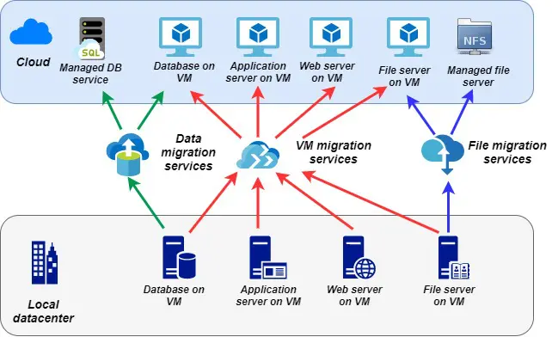
Mockup/Flow Diagram/Prototype
The exact architecture diagram has not been used for proprietary reasons

Slide 25
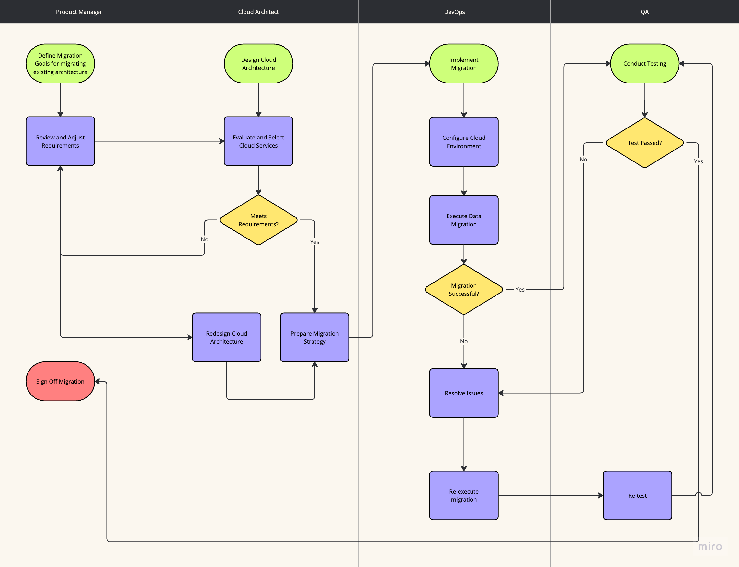
High Level Use case diagram
The exact architecture diagram has not been used for proprietary reasons

Slide 26
Work Breakdown Structure
Epic 1: Project Planning and Requirement Analysis
User Story 1: Define Project Goals and high level metrics
Identify Stakeholders
User story 2: Document Infrastructure, application data
Use case 4: Risk Assessment
Use case 5: Budget
Epic 4: Application migration and testing
Use case 1: App testing
Use case 2: app migration planning
Use case 3: App migration execution
Epic 7: Knowledge transfer and documentation
Use case 1: documentation of new environment
Use case 2: training for IT
Epic 8:
Go Live and Post migration
Use case 1: Final testing and go live readiness
Use case 2: Go Live execution
Epic 5: Security and compliance
Use case 1: compliance assessment
Use case 2: security controls
Use case 3: ongoing security monitoring
Epic 2: infrastructure and Design
Use case 1: Define cloud architecture
Use case 2: Choose cloud services
Use case: setup security framework
Epic 3: Data Migration Planning
Use case 1: Data backup
Use case 2: Data transfer and storage
Use case 3: Data migration
Use case 4: Post Migration validation
Epic 6: Ops readiness
Use case 1: Monitoring and Alerting
Use case 2: Cost optimization
Use case 3: Performance tunning
Epic 9:
Use case 1: Post migration Performance review
Use case 2: Project closure and handover

Slide 27
RACI
Project Activity | Product Manager | Project Manager | Cloud Architect | IT Security Team | Developers | Operations Team | Business Stakeholders | External Vendor/Cloud Provider
1. Project Planning & Requirements Gathering | R | A | R | C | C | I | C | I
2. Cost and Budget Analysis | A | R | C | I | I | I | C | I
3. Risk Assessment | A | A | C | R | I | I | I | I
4. Security and Compliance Planning | A | C | C | A | I | I | I | C
5. Data Backup and Storage Strategy | A | C | R | C | A | I | I | C
6. Infrastructure Design & Architecture | C | C | A | C | I | I | I | C
7. Application Compatibility Testing | C | C | R | C | A | I | I | I
8. Migration Planning (Phased/Rolling) | C | R | A | C | C | I | I | C
9. Setting Up Cloud Environment | C | C | A | C | C | I | I | R
10. Data Migration Execution | C | C | R | I | A | I | I | I
11. Application Migration Execution | C | C | R | I | A | I | I | I
12. Monitoring & Performance Tuning | C | C | R | C | C | A | I | I
13. Uptime and Availability Management | C | I | C | C | I | A | I | I
14. Security & Access Control Management | C | C | C | A | I | R | I | I
15. Post-Migration Testing | C | R | C | C | C | A | I | I
16. Documentation & Knowledge Transfer | C | A | R | C | C | C | I | I
17. Final Cost and Performance Review | C | A | C | I | I | I | R | I
18. User Training and Support | C | A | C | I | I | R | C | I
19. Project Closure and Handover | A | A | R | C | C | I | C | I

Slide 28
Financial Planning and Budget
Please refer to the budget excel sheet for detailed explanation
Category | Estimated Cost
Planning and Assessment | $20,000 - $30,000
Infrastructure and Design | $35,000 - $45,000
Cloud Service Costs (1st Month) | $35,000 - $50,000
Application Migration | $65,000 - $85,000
Security and Compliance | $25,000 - $30,000
Operational (Monthly) | $10,000 - $13,000
Contingency (10-20%) | $40,000 - $50,000
Total Initial Budget Estimate | $200,000 - $350,000

Slide 29
Assumptions
Clear business objectives and Requirements: Scalability, cost savings, operational efficiency has been defined and aligned with the stakeholders
Stable source environment: The application codebase is compatible with the target cloud environment. The existing on prem and legacy environment is stable and fully documented for a smooth migration process.
Availability of skilled resources and or training has been provided to bridge the gap
Support from Cloud Provider: The cloud provider will provide sufficient support, network capacity, resources, and guidance to address technical challenges during migration.
Budget and Time allocation: Project has sufficient budget and timeline to complete all phases including refactoring
Minimal Application Downtime Tolerance: Assumes that applications and services can handle minimal downtime during migration
User readiness and Change management: Users are prepared for changes to workflows and tools, and that there is a change management plan in place to handle training and support. Changelog will be maintained for all changes including scope creep
Availability of Backup and Rollback Options: Data can be restored in cased of migration issues

Slide 30
Dependencies
Infrastructure Readiness: Required cloud infrastructure (e.g., VPCs, IAM) will be provisioned by the cloud provider’s setup team.
Compliance and Security policies: Collaboration with [IT team, DevOps, security team] is necessary to meet compliance and security requirements.
Data Transfer: Dependence on networking infrastructure, such as high-speed internet or dedicated VPN connections, to support large-scale data transfer without interruption or bottlenecks.
Application Compatibility: Dependency on applications being compatible with the target cloud environment or having alternative solutions if they require modification or refactoring.
UAT: Sign off from stakeholders after end to end testing to validate feedback and functionality
Change Management: Ensure users and staff are informed, trained, and supported through the transition to cloud-based workflows.
Service Level Agreements (SLAs) with Cloud Provider: Dependence on cloud provider SLAs to ensure uptime, support, and response times meet organizational requirements, especially for critical applications.
Access to Technical Support from Cloud Provider: Dependency on timely and effective support from the cloud provider to address any technical issues that arise during migration.
Stakeholder Engagement and Communication: Dependency on active engagement and feedback from stakeholders, including regular updates to ensure alignment and address concerns promptly.
Setting up testing environment to validate applications
Data and Application interdependencies: Migrated in tandem and closely coordinated to avoid functional disruptions

Slide 31
Gap Analysis for scope creep
Original scope: Migrate applications to the cloud with only the essential refactoring required for compatibility and not for optimization.
Scope Creep: Stakeholders requested additional refactoring, feature enhancements and move to AWS Lambda serverless
Area | Original Scope | Current Scope Creep Risk | Impact
Refactoring Depth | Minimal refactoring for compatibility only. | Requests for full refactoring or re-engineering to use cloud-native models. | Increased project timeline and cost.
Feature Enhancements | No feature enhancements; migration only. | Stakeholders push to add new features or improvements. | Potential delays and additional development.
Performance Optimizations | Basic compatibility testing, no major optimizations. | Developers may be encouraged to optimize application performance specifically for the cloud. | Increased time for testing and development.
Security Enhancements | Basic cloud security configurations applied. | New security requirements, such as enhanced encryption or advanced compliance logging. | Additional time, cost, and resource needs.
Modernization Goals | Limited refactoring to maintain functionality. | Push for extensive modernization of legacy applications. | Major increase in migration complexity.

Slide 32
Recommendations to Control Scope Creep
Define and Document Clear Boundaries
Implement a Formal Change Request Process
Stakeholder Alignment and Communication
Establish Success Criteria for Minimal Refactoring
Prioritize Post-Migration Enhancements
Limit Refactoring to Cloud Compatibility Needs Only

Slide 33
Key Metrics for Tracking Scope Creep
Number of Change Requests Approved
Time and Cost Variance from Original Estimates
Application Refactoring Hours
Post-Migration Enhancement Log

Slide 34
Launch: Key Milestones
TARGET DATE | MILESTONE | DESCRIPTION | EXIT CRITERIA
YYYY-MM-DD | Pilot/soft launch | Internal testing with employees only | No P0 or P1 bugs on a rolling 7-day basis
YYYY-MM-DD | Beta | Early cohort of 20 customers | At least 10 customers would be disappointed if we took it away
YYYY-MM-DD | Early Access | Invite-only customers from sales | At least 1 win from every major competitor
YYYY-MM-DD | Launch | All customers in current markets | Measure and monitor

Slide 35
Launch checklist
Please refer to the excel sheet attached for launch and final go checklist

Slide 36
Post Launch
Stabilization (Initial 2-3 Months)
Monitor system performance and availability
Run Performance Benchmarks and Load Tests
Validate Data Integrity and Consistency
Implement Change Management and Monitor for Errors
User Training and Support
Continuous Monitoring and Maintenance (Ongoing)
Set Up Alerts for Key Performance Indicators (KPIs)
Proactive Security and Compliance Audits
Manage and Optimize Resource Utilization
Cost Optimization and Reporting
For more details please refer to the word template

Slide 37
Post Launch
Performance Optimization and Continuous Improvement
Optimize Application Performance
Refine Data Pipelines and Analytics Workflows
Implement DevOps and Automation
Gather User Feedback for Continuous Improvement
Maintain Documentation and Knowledge Transfer
Continuous Training and Support
Stakeholder Communication and Reporting
Establish a Support Framework
For more details please refer to the word template

Slide 38
Post Launch
Roadmap for Future Enhancements and Optimization
Identify Future Cloud Initiatives: AI/ML initiatives
Plan for Advanced Cloud Capabilities
Schedule Regular Post-Migration Reviews
For more details please refer to the word template

